Slide 1
Cm/ecf
United States District Court
Central District of Illinois
February 5, 2011
UPDATE ON LOCAL RULES
QUESTIONS ABOUT ELECTRONIC FILING

Slide 2
Central District of Illinois public website www.ilcd.uscourts.gov

Slide 3
Central District of Illinois website is an interactive tool providing information specific to the Court, information on additions to the system and answers to frequently asked questions
Link especially “for Attorneys”
Link to Electronic Case Filing
Link to Local Rules
Link to AO forms
Directory of Judges
Directory of Clerk’s Office locations and email addresses
Link to training modules for CM/ECF

Slide 4
INFORMATION FOR ATTORNEYS

Slide 5
Provides link to CM/ECF
Wireless access information
Frequently asked questions about CM/ECF
CJA attorney forms
Informational updates on concerns of the court
Attorney registration forms for the Central District of Illinois electronic filing system
Court fee schedule

Slide 6
Tutorials on new functionality
Civil case opening instructions
Sealed documents
Maintenance of user accounts

Slide 7
ELECTRONIC CIVIL CASE OPENINGS
New functionality has been added to CM/ECF which will allow an attorney to file a complaint electronically with a credit card
Complaints can be filed 24 hours a day
System is set up to randomly assign the judges after the transaction is complete
Step-by-step instructions to filing can be found on the website

Slide 9
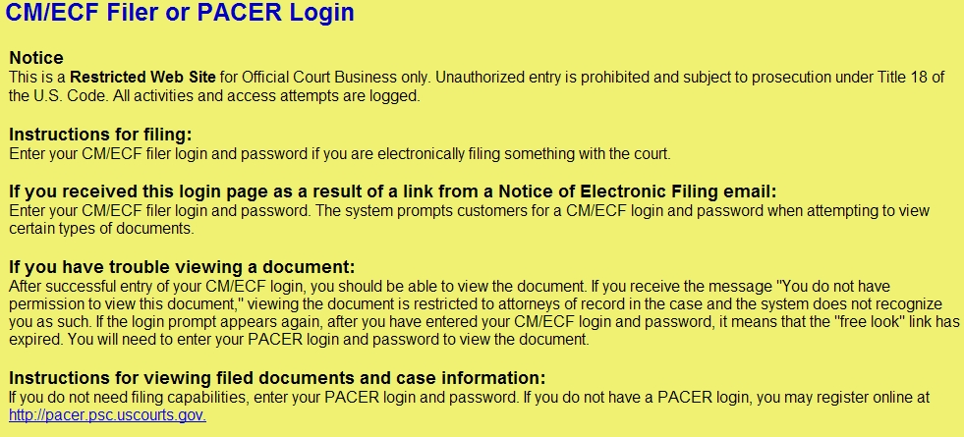
CIVIL CASE OPENING
Log on to the CM/ECF system using your login and password, making sure to check the box regarding redaction issues.

Slide 10
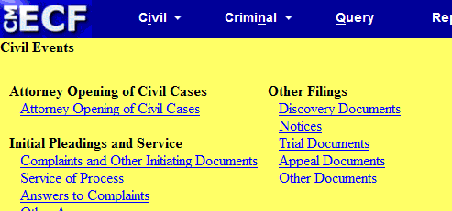
Click on Civil in the blue tool bar located at the top of the page.
Click on Attorney Opening of Civil Cases.

Slide 11
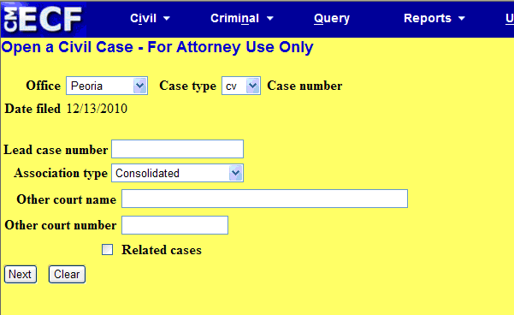
Choose correct office for filing from drop down box. Verify that the Case type is cv. (Note: If you are not sure which office is applicable, please refer to the Local Rules to determine correct location). DO NOTHING ELSE ON THIS SCREEN.
Click next.

Slide 12
You will now see a screen which asks for specific statistical information regarding your case. This information is the same information that you provide on your civil cover sheet. Please refer to your completed civil cover sheet for information. Fill in the appropriate boxes by clicking on the down arrow located at the end of each informational box.
Please note that it is mandatory to fill in the Jurisdiction, Cause of Action, Nature of Suit and Origin boxes. If you are paying by credit card, the fee status selection should be paid.

Slide 13
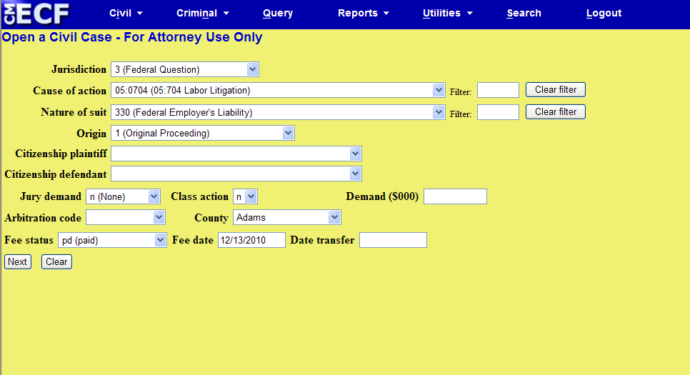
Once all appropriate boxes are complete, click next.

Slide 14
You will now see a screen in which you may add parties. You will note that this screen is a split screen. Please pay special attention to which side of the screen you are working.
To add parties, type in plaintiffs first and last names in the appropriate box on the right side of your screen. Click Search. A Search Results box is displayed and below the box there are two buttons, one which says Select Party, and one which says Create New Party.

Slide 15
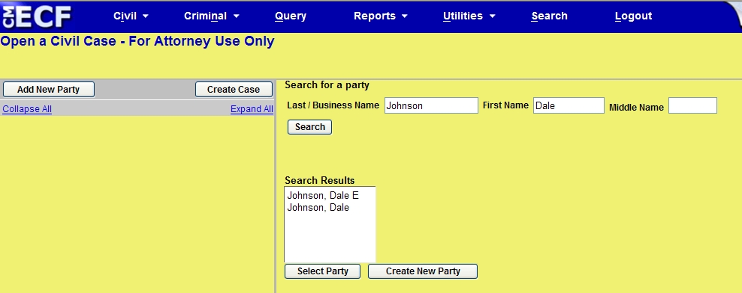
Click on Create New Party.

Slide 16
The Party Information Screen now appears on the right side of your screen. Your plaintiff’s name will be in the appropriate boxes in this screen. You will need to change the role of the party by clicking on the drop down box arrow, and selecting the correct role (in this case, plaintiff). Enter no other information on this screen. On the bottom of the screen is a button that says add party (you may have to use your scroll bar located on the far right hand side of your screen to be able to see the add party button).

Slide 17
Click on the add party button (located on the bottom right hand side of your screen), NOT the “add new party” button (located on the top left hand of your screen). You will note that if done correctly, your party has been added to the party tree on the left side of your screen. If you should click on the “add new party” button in error,
your party will not be added to the party tree and you will need to re-enter the information on the right side of your screen. It is imperative to always check the party tree located on the left side of your screen to verify that your parties are being added.

Slide 18
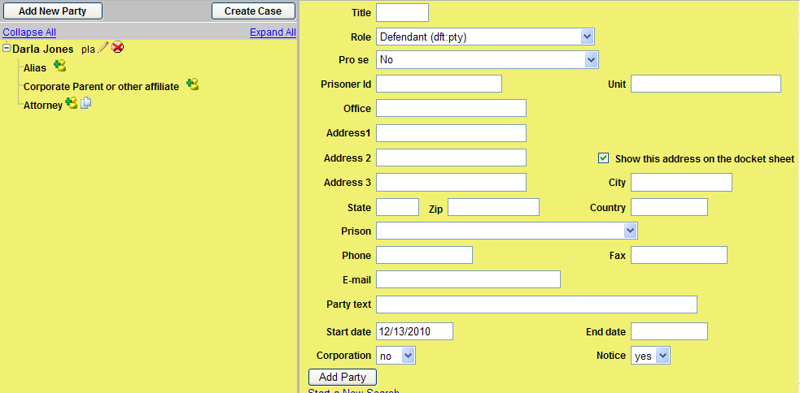
DO NOT HIT YOUR BROWSER BACK BUTTON IN AN ATTEMPT TO CORRECT ERRORS.
You will note that your plaintiff’s name has now been added to the left side.

Slide 19
You are now ready to enter another party. To do this you once again go to the right side of your screen, adding names as you did above making note to change your role types as appropriate. As you continue to add parties the names will appear on the left side of the screen also. Once all parties have been entered, you will notice on the left side of your screen, above the party names a button that says “Create Case”. Click on this button.

Slide 20
A screen appears that says “Case will be created. Proceed?”. If you have entered your parties correctly, have your credit card ready, and have your complaint ready to attach (in pdf format), click ‘Yes’ to proceed.
Your case has now been created and a case number is assigned.
NOTE: Once you have clicked the “create case” button , DO NOT HIT YOUR BROWSER BACK BUTTON in hopes of correcting any errors to your case. Please contact the clerk’s office with any questions.

Slide 21
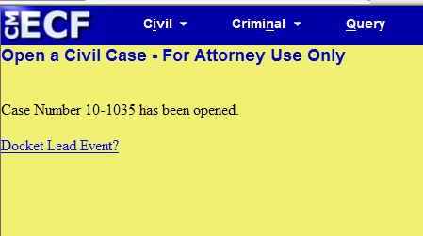
You will notice that this screen displays your case number and asks if you would like to docket lead event. Click on the link “Docket Lead Event”.

Slide 22
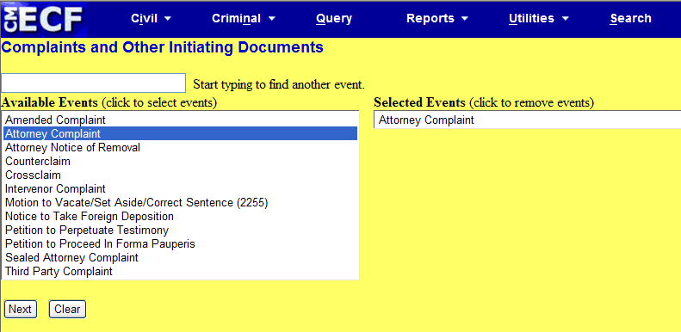
From this screen choose “Attorney Complaint” or “Attorney Notice of Removal” (whichever is appropriate) from the list of ‘Available Events’ and click next.
An informational screen appears with the case number that has been assigned to your case.
Click Next.

Slide 23
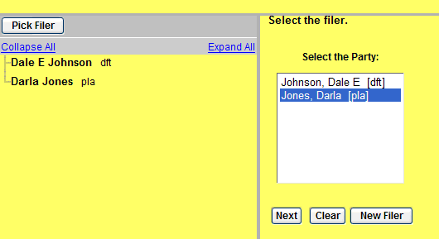
On this screen you will see that you once again have a split screen. On the left side of your screen you will see the plaintiff(s) and defendant(s) that you have entered. On the right hand of the screen all parties appear in a box. At the top of the split screen on the right hand side you will see that you are being asked to ‘select the filer’ . YOU ARE THE FILER. Click next.

Slide 24
A screen appears that tells you that an attorney/ party association does not exist for this party and yourself, and would you like to make this association. The box is already checked by default. You will also notice that there is a box that can be marked if you are the lead attorney. Local Rule 11.2 - Designation of Lead Counsel on Initial Pleading states: “When a party’s initial pleading is filed, counsel must designate as lead counsel the attorney who will be responsible for receipt of telephone conference calls. Only one may be designated.” If you are the lead counsel, mark this box. If not, leave it blank. Click next.

Slide 26
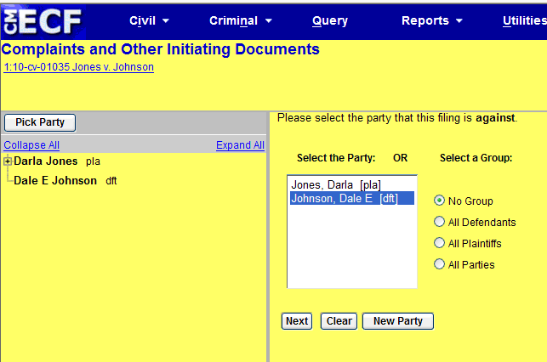
A split screen once again appears. On the right side of this screen it is asking - “Please select the party that this filing is against”. Pick the appropriate party from the box by clicking on the name (it will turn blue), and then clicking on next.

Slide 27
A screen appears in which you are to attach your complaint or notice of removal (required) and any attachments(i.e. summons, exhibits).To do this, next to the main document box there is a browse button(the main document will always be either the complaint or notice of removal) . Browse for your complaint or notice of removal (that you have in pdf format). Once you have selected this document, the link will appear in the box under “main document”. Follow the same steps for the attachment boxes by browsing for your remaining documents (i.e., civil cover sheet, summons), making sure to fill in either the category or description of these documents.

Slide 28
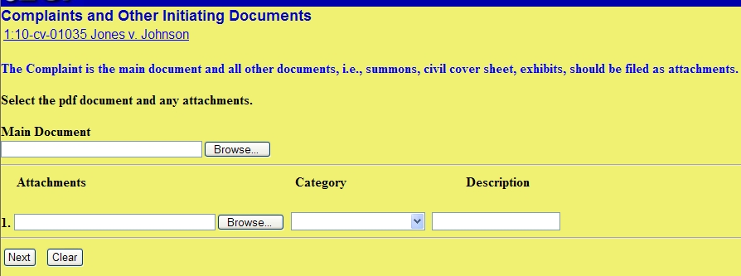
IMPORTANT : If you are seeking ifp status, DO NOT attach your motion for ifp to this transaction. Once your case has been opened, and complaint filed, you may proceed in filing your motion for ifp by logging into the CM/ECF system; click civil on the blue tool bar; select motions/petitions, pick proceed in forma pauperis from the drop down box, hit next; follow the interactive screens to complete filing ).
Once finished, hit next.

Slide 29
This screen asks you if you are requesting ifp status or filing on behalf of the USA. Fill in the appropriate response. If you are filing on behalf of the USA or are requesting IFP status, you would enter “y” in this box and hit next; if not, and are ready to pay by credit card, you would put a “n” in the box, and then click next.
The next screen is a reminder that the filing fee is $350. Click next.

Slide 30
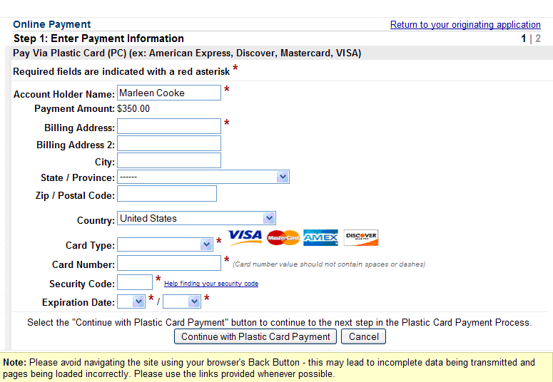
A screen now appears that asks for your credit card information. Fill in the appropriate boxes, verify, and then click on “continue with plastic card payment”.

Slide 31
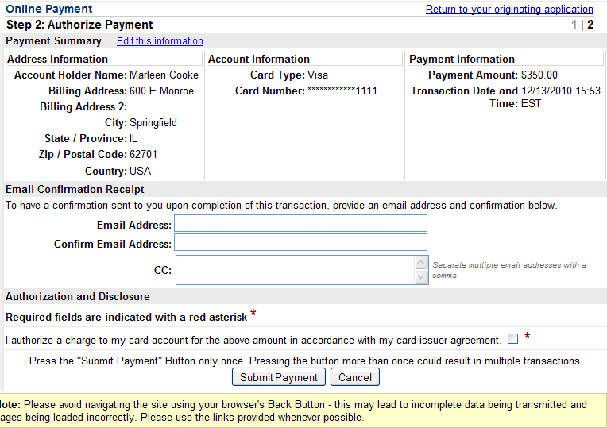
An Authorize Payment screen now appears. Verify the information on this page. If you would like confirmation of this payment sent to you, enter your email address in the appropriate boxes. Once you have filled in all appropriate boxes, mark the authorization box at the bottom of the page by clicking in the box, click next.

Slide 32
WARNING: Once you have clicked on the “submit payment” button, your credit card has been charged the $350 filing fee, regardless of whether you finish the transaction. DO NOT HIT
YOUR BROWSER BACK BUTTON in an attempt to make corrections to your case. Doing
so may result in double charges to your credit card.

Slide 33
If your payment is accepted, you will get a screen that shows you: Complaint against “your defendant” (Filing fee $350, receipt number *******), filed by “your plaintiff”.
If all appears correct, click next:

Slide 34
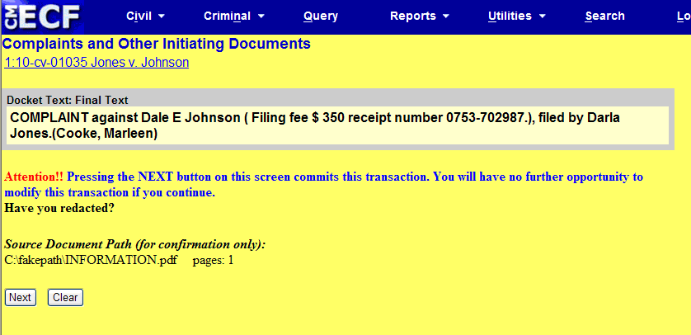
A final docket text screen appears. Click on next to commit this transaction

Slide 35
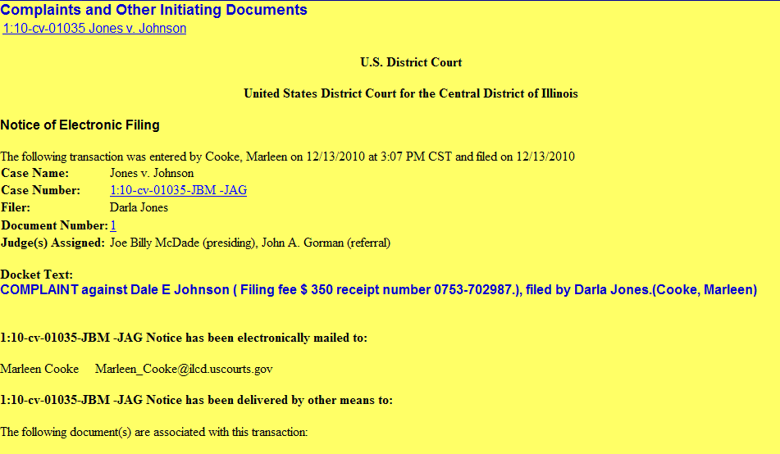
A Notice of Electronic filing now appears. Please note that the Notice of Electronic filing informs you of the judges which have been assigned to your case.

Slide 36
Attachments and Exhibits (Local Rule 5.8)
Documents with attachments and exhibits greater than 30 pages must have a courtesy paper copy delivered to the presiding judge’s chambers.
Non-trial exhibits that are not readily available in electronic form can be conventionally filed.
Trial exhibits will not be scanned into the electronic record unless specifically ordered by the Judge.

Slide 37
TECHNICAL ISSUES – HELPFUL HINTS
Documents are to be filed in pdf format. For proper archival preservation, the National Archives and Records Administration (NARA) recommends that documents be scanned at a setting of 300 dots per inch (dpi). (Local Rule 5.8).
When attaching a document, if you get a message that your document is too big, even though it is only a few pages, it may be the result of your document being scanned.
Check your scanner settings to be sure that they are 300 dpi.
Convert your document to pdf using adobe program instead of relying on your scanner to convert

Slide 38
SEALED DOCUMENTS (Local Rule 5.10)
The Court does not approve of sealing parts of the record as a general matter.
In the rare event that a motion itself must be filed under seal, the motion should be filed using the event “Sealed Motion”.
A party who has a legal basis for filing a document under seal must file a motion for leave to file under seal unless prior court approval has been granted.

Slide 39
The motion must include an explanation of how the document in question meets legal standards for filing sealed documents.
The document in question is filed contemporaneously using separate docket event “Sealed Document”.
A publically viewable notice of electronic filing is generated, but the document is not viewable electronically, by the public or by parties.
Service of the sealed document must be made in accordance with the Federal Rules of Civil Procedure and the Local Rules of this Court.

Slide 40
If the motion to file under seal is denied, the sealed document tendered will remain under seal and will not be considered by the presiding judge.
If the filer wishes to have the denied document considered by the Court, it must be re-filed in the normal fashion.
The Court may, in its discretion, order a sealed document to be made public if:
The document is filed in disregard of legal standards.
The document is so intricately connected with a pending matter that the interest of justice are best served by doing so.

Slide 41
Rules applicable to sealed documents also apply to documents submitted for in camera review.
A party who has a legal basis to file a submission without notice to other parties should file the submission electronically as an “ex parte document” or “ex parte motion” .

Slide 42
SEALED DOCUMENTS
Log on to the CM/ECF system using your login and password, making sure to check the box regarding redaction issues.

Slide 43
First we will file your motion for leave to file under seal.
This motion WILL NOT BE sealed, will be sent via NEF to counsel of record, and will be available on PACER; therefore, special care should be taken to ensure that the motion does not include any sensitive information.
Click on Civil in the blue tool bar located at the top of the page.
Click on Motions/Petitions.

Slide 45
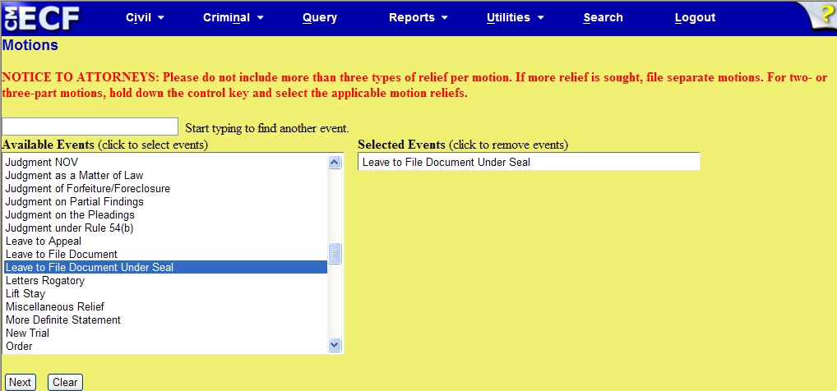
From the drop down box, click on “Leave to File Document Under Seal”.
Click Next.

Slide 46
Enter appropriate case number.
Click next.

Slide 47
A split screen now appears.
The left side of the screen displays all parties to the case. The right hand side asks that you select the party who is filing the motion.
YOU ARE THE FILER.
Choose your client by clicking on the appropriate name in the box on the right side of the screen.
To make multiple selections, hold down your control button while clicking on the names.
Once selection(s) are made. Click next

Slide 49
A screen now appears with an instructional message for attorneys regarding an upcoming screen. Please pay special attention to this message. Once read, click next.

Slide 50
This screen is where you will attach your motion for leave under seal which you have saved in .pdf format.
Remember this event is your motion asking for leave to file your sealed document and therefore this filing is NOT SEALED.
DO NOT ATTACH YOUR SEALED DOCUMENT to this event.
Once you have browsed for your motion. Click next.

Slide 52
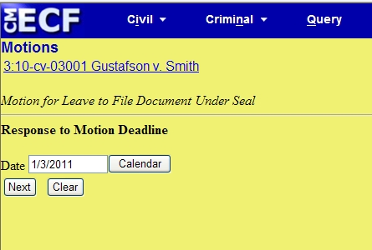
On this screen the deadline for opposing counsel to file a response to your motion is displayed.
DO NOT CHANGE THIS DATE.
Click next.

Slide 53
This is your docket text screen. The wording that is displayed will be the entry on the docket sheet.
Add any appropriate modifiers in the boxes provided.
Click next.

Slide 54
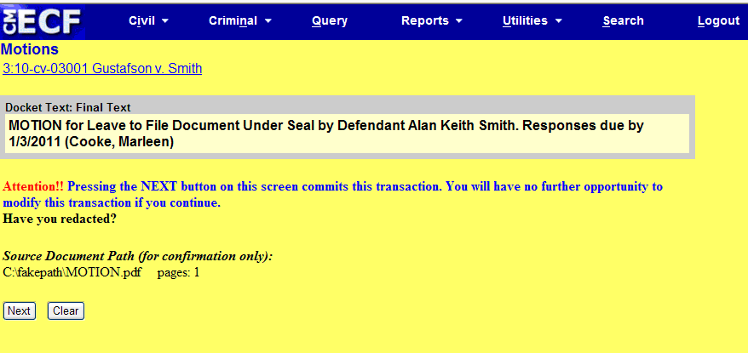
This is your final screen. You will have no further opportunity to modify this transaction if you continue.
Verify information displayed.
Click next.

Slide 55
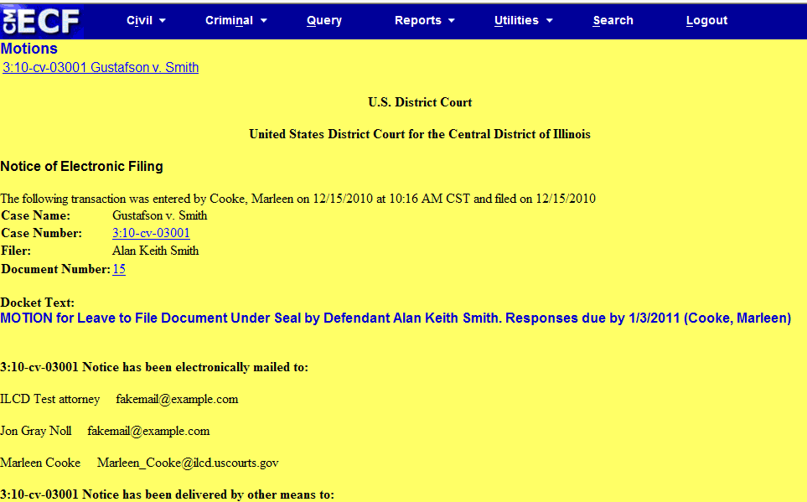
NEF. Transaction complete.

Slide 56
You are now ready to file the sealed document.
A text entry will show on the docket sheet for this document, but will simply read “SEALED DOCUMENT”. This text entry is not sealed, and is viewable on PACER.
A NEF will be sent to counsel of record showing that a sealed document has been filed.
The document itself is sealed, is NOT SENT to opposing counsel, and is not viewable on PACER. If it is appropriate for counsel to receive a copy of this document, you must make other arrangements to provide that copy as appropriate.

Slide 57
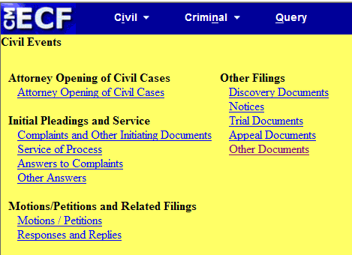
Click on Civil in the blue tool bar located at the top of the page.
Click on Other Documents.

Slide 58
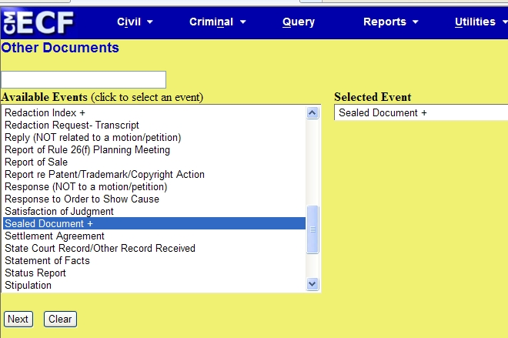
Choose Sealed Document + from drop down box.
Click next.

Slide 59
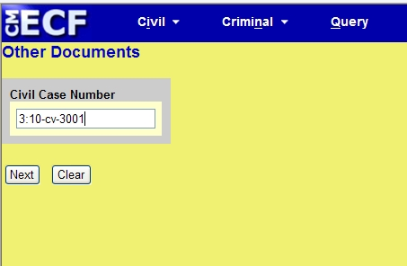
Enter appropriate case number.
Click next.

Slide 60
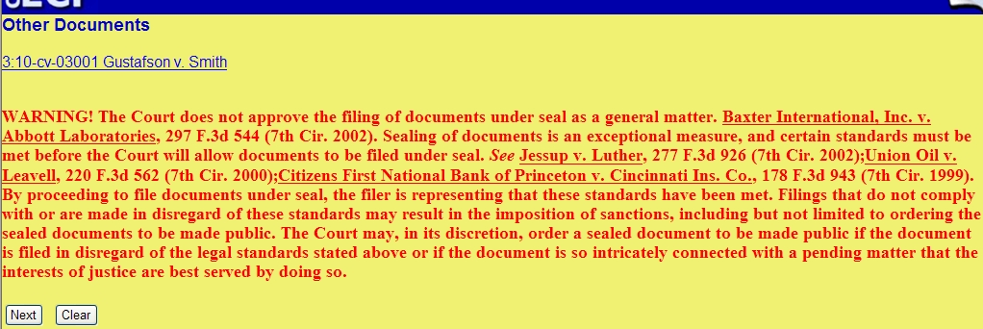
Warning screen appears setting out Court’s view on the filing of sealed documents.
After reading, click next.

Slide 61
A split screen now appears.
The left side of the screen displays all parties to the case. The right hand side asks that you select the party who is filing the motion.
YOU ARE THE FILER.
Choose your client by clicking on the appropriate name in the box on the right side of the screen.
To make multiple selections, hold down your control button while clicking on the names.
Once selection(s) are made. Click next

Slide 63
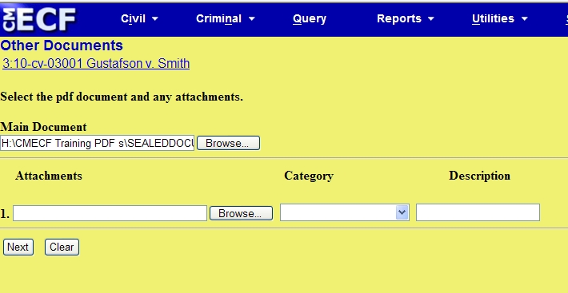
Browse for your sealed document and any attachments that you have saved in pdf format.
Your document name will appear in the box to the left of “browse”.
Click next.

Slide 64
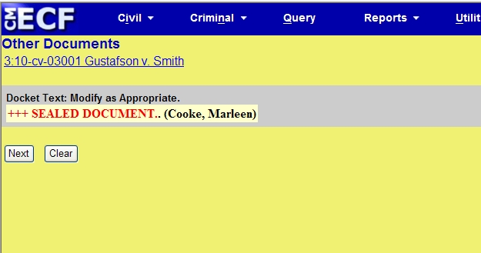
Docket text screen appears. This is what will appear on docket sheet.
Click next.

Slide 65
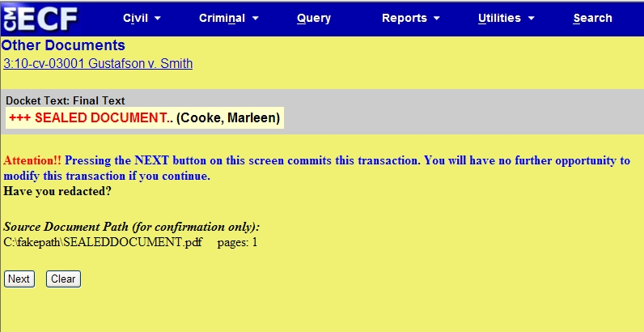
This is your final screen. You will have no further opportunity to modify this transaction if you continue.
Verify information displayed.
Click next.

Slide 66
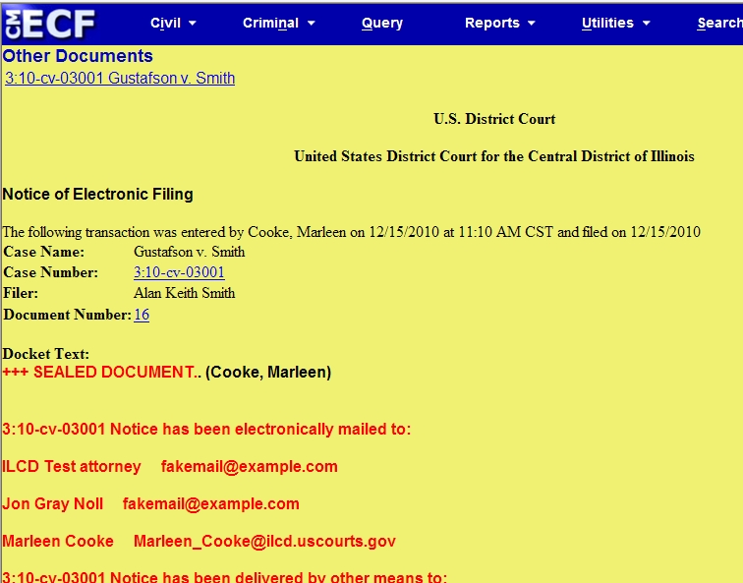
NEF. Transaction complete.
REMEMBER: THE DOCUMENT ITSELF IS SEALED AND HAS NOT BEEN DELIVERED TO COUNSEL OF RECORD VIA THIS NEF. IF APPROPRIATE, PROVIDE COUNSELWITH A COPY OF THE DOCUMENT.

Slide 67
PRIVACY - REDACTIONS (Local Rule– RULE 5.11)
To address privacy concerns created by Internet access to court documents, litigants must modify or partially redact certain personal identifiers in court documents.
Fed.R.Civ.P. 5.2 directs that filing parties make the following modifications in documents that contain an individual’s social security number, tax-payer ID number, birthdate, the name of a known minor or financial account number:

Slide 68
Display only:
1. The last 4 digits of the social security number and tax payer id number;
2. The year of the individual’s birth;
3. The minor’s initials; and
4. The last four digits of the financial account number.
In addition to those set out in Fed.R.Civ.P. 5.2 these identifiers and suggested modifications are:
1. Addresses: Use only City and State.
2. Signatures: Use s/name; and
3. Driver’s license numbers: use last 4 numbers.

Slide 69
Litigants should consider redacting or filing under seal any document that might bring harm to anyone or should not be made public for law enforcement or security reasons.
It is the responsibility of filing party to make these redactions. It is not the responsibility of the Clerk’s office to make redactions.
When redactions result in a document’s intent being unclear, or if ordered by the Court, the filing party must file under seal an unredacted document or reference list.

Slide 70
If an unredacted version is not filed, the unredacted version of the document or reference list must be retained by filing party for one year after completion of the case, including appeals.
Upon showing that the redacted information is relevant and legitimately needed, the Court may, in its discretion, order the information disclosed to counsel for all parties.

Slide 71
Transcript redactions:
Parties and attorneys may order transcripts.
Court reporter will file the transcript electronically.
Transcript will be available for viewing at Clerk’s Office public terminal, but may not be copied or reproduced by Clerk’s Office for 90 days.
Parties must file Notice of Intent to Request Redaction within 7 days of the filing of transcript.
Responsibility for identifying material that should be redacted lies solely with counsel and parties.
Within 21 days of filing of transcript, parties must file under seal, a motion of requested redactions indicating material to be redacted by page and line.
If a party fails to follow procedures for requesting redaction, or if no redactions are requested, the official transcript will be made electronically available to the public 90 days after initial filing with Clerk.

Slide 72
Pro Se prisoners need not redact documents unless ordered by presiding Judge.
Non-prisoner pro se parties must comply with redaction rules.
Documents filed in Social Security cases need not be redacted unless so ordered by presiding Judge.

Slide 73
Designation of Lead Counsel on Initial Pleading Local Rule 11.2
Local Rule 11.2 states:
“When a party’s initial pleading is filed, counsel must designate as lead counsel the attorney who will be responsible for receipt of telephone conference calls. Only one may be designated.”
The court is noticing that this step is being omitted, or that numerous attorneys are being designated as lead counsel.

Slide 74
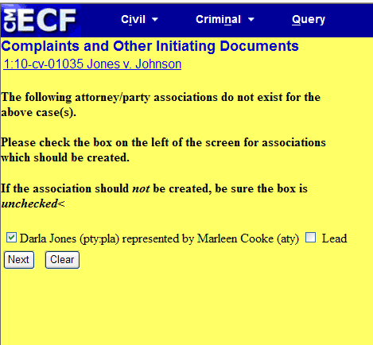
Lead designations can be made when an initial pleading is filed. A box appears that asks for the association to be made between attorney and party, and also includes a box for lead designation. Putting a check in the “lead box” will create a designation.

Slide 75
Designations of lead counsel can also be made by filing a separate document setting forth the individual who will be taking on the responsibility of lead counsel.
Care should be taken to make certain that only one individual per party is designated as lead.

Slide 76
ELECTRONIC SIGNATURES LOCAL RULE 11.4
Use of a login and password for electronic filing constitutes the same force and effect as the filer’s signature.
Electronic filers should sign their documents s/Attorney Name; documents signed by an attorney MUST USE THAT ATTORNEY’S LOG IN AND PASSWORD to be considered valid.
Where multiple attorney signatures are required, such as a joint motion or stipulation, the filing attorney may enter the “s/” of the other attorneys to reflect their agreement.

Slide 77
If a document requires the signature of person(s) not registered for electronic filing (settlement agreement with pro se party; witness’ affidavit) the filing party must confirm content of document is acceptable to all person(s) required to sign and original signatures must be obtained before filing of document.
Filing party must redact original signature and e-file redacted version of document. Document must indicate identity of each non-registered signatory in the form “s/Jane Doe”. A certificate of service must be filed with document.

Slide 78
The filing party must retain the original document until one year after the date judgment is final.
The electronically filed document as maintained on the court’s servers constitutes the official version of that record. The court will not maintain a paper copy of the original document except as otherwise provided in the Rules.
Any party or non-filing signatory who disputes authenticity of an electronically filed document or signatures on that document must file an objection within 14 days of receiving notice that the document has been filed.

Slide 79
RULE 16 PLAN (LOCAL RULE 26.2)
The parties must file a proposed discovery plan which meets the requirements of Fed.R.Civ.P.26(f). The attorney for the plaintiff is responsible for arranging the meeting and filing the proposed discovery plan.
Judge - specific instructions can be found at www.ilcd.uscourts.gov under Local Rules.

Slide 80
Be sure to check these specific rules to verify that you are in compliance with the Local Rules.
The proper event to e-file the proposed discovery plan can be found at the civil menu:other filings/other documents/Report of Rule 26(f) Planning Meeting.

Slide 81
PACER
CM/ECF and PACER login screens are very similar in appearance which can lead to confusion on which login and password to enter.
When FILING a document, the court provided CM/ECF login and password should be used.
When attempting to VIEW a document or docket sheet, even from the CM/ECF screen, a login screen will appear. You must enter your PACER login and password to view documents.

Slide 82
Occasionally when attempting to view a document from the NEF, a login screen appears prompting for the PACER login/password, even though the user has not received their “free look”. Possible reasons include:
The link has been double clicked, instead of single clicked. If the link is double clicked, a PACER login screen appears and the user must enter their login/password and will be charged.
A firewall is enabled which blocks pop ups. This will cause a PACER login screen to appear. EVERY TIME the user clicks a link on an NEF, a login/password will be required, and the user will be charged.
The NEF is more than 14 days old.

Slide 83
ADDITIONAL INFORMATION
Electronic notification is dependent on diligent maintenance of an attorney’s account.
How to update email addresses
How to change passwords

Slide 84
To change your e-mail addresses:
Log onto the CM/ECF system.
Click on Utilities/Your Account/Maintain Your Account.
Click on Email information button at the bottom of the screen.
E-mail information for your account will be displayed. Update your e-mail addresses as appropriate; a primary e-mail address must be added before you can enter secondary e-mail addresses.
NEF configuration options can also be made on this screen; Make any necessary additions/changes.
Click on Return to Person Information Screen button located on the left side of your screen.
Click Submit button located at the bottom left of your screen to complete transaction.
Verification of successful transaction screen appears.

Slide 85
UPDATING E-MAIL ADDRESSES
Click here

Slide 86
Click here

Slide 87
This is the screen that will appear. To view NEF options, click on the link to the primary email address. If you do not have a primary email address listed, you cannot add secondary email addresses.

Slide 88
The screen to your right will allow you to configure your NEF Appearance. You can also add additional cases that you would like to receive notice on.

Slide 89
IMPORTANT: You MUST hit the “return to Person Information Screen” above when you have made the appropriate selections to the configuration options.

Slide 90
IMPORTANT: After you have made all necessary changes, you MUST hit the submit button or the changes will not be saved.

Slide 91
A SECOND SUBMIT SCREEN APPEARS. BE SURE TO HIT SUBMIT TO SAVE THE CHANGES TO YOUR ACCOUNT.

Slide 92
This is your final screen. If you have completed the transaction successfully you will see this screen.

Slide 93
PASSWORDS (Local Rule 5.6)
Each attorney admitted to practice in the Central District of Illinois will obtain a CM/ECF login and password.
Use of this login and password for electronic filing constitutes the same force and effect as the filer’s signature (See Local Rule 11.4).
It is the attorney’s responsibility to keep this password secure.
It is recommended that attorneys change their passwords occasionally to maintain security of their signature.

Slide 94
To change your password:
Log onto the CM/ECF system.
Click on Utilities/Your Account.
Click on Maintain Your Account.
Click on More User Information button at the bottom of the screen.
Your login will be displayed; your password will display as *****.
Enter your new password over the *****.
Click on Return to Account button.
Click on Submit button to return to the account screen.
Click on Submit to complete transaction.
Verification of successful transaction screen appears.

Slide 95
UPDATING PASSWORDS
Click here

Slide 96
Click here

Slide 97
This is where you will change your password. Enter your new password over the ********. When finished, click on Return to Account Screen

Slide 98
Click submit to complete transaction

Slide 99
Verification of successful transaction

